Slide 1
With SFT and GRPO
Exploring LoRA for Math Reasoning
Lusha Zhang

Slide 2
01
04
02
05
03
06
TABLE OF CONTENTS
Intro and Definition
Project Workflow
Motivation
Results Review
Methodology
Key Learnings

Slide 3
01
Intro and Definition

Slide 4
Intro
Modern LLM training pipeline =
Pre-training + Post-training
Foundation-building Stage
Behavior-shaping & Specialization Stage
Learn general language ability from large-scale data.
Adapt the pretrained model for instruction following, alignment, and specific tasks.

Slide 5
Post-training
Training Methodology
SFT - Supervised Fine-Tuning
on input-output examples to teach the model how to respond.
RFT - Reinforcement Fine-Tuning
improves the model using rewards instead of only fixed target answers.
└──
GRPO - Group Relative Policy Optimization
an RFT method that trains the model by rewarding better answers within a group of sampled outputs.
Model Update Methodology
PEFT - Parameter-Efficient Fine-Tuning
updates only a small subset of parameters to adapt a pretrained model more cheaply.
└──
a PEFT method that freezes the base model and learns small low-rank adapter weights instead of updating all parameters.
LoRA -
Low-Rank Adaptation

Slide 6
02
Motivation

Slide 7


7,000,000,000+
Motivation –
Paper Learning to Reason in 13 Parameters*
Full model Qwen2.5-7B-Instruct parameters update on GSM8K (accuracy 76%-97%**)
1,000,000+
Standard LoRA / SFT setup update on GSM8K (accuracy 76%-98%)
What is
TinyLoRA ?
13
TinyLoRA / GRPO on GSM8K (accuracy 76%- 91%)
* https://arxiv.org/pdf/2602.04118
** estimated from the chart in the paper

Slide 8
03
Methodology

Slide 9
Fine-Tuning Lineage
LoRA
2021
1
Low-rank adapters make model adaptation cheap enough to compare multiple ranks locally.
GRPO
2024
2
DeepSeekMath brought GRPO into reasoning RL and motivates group-relative optimization for math.
LoRA-XS
2024
3
Uses frozen SVD factors plus a tiny trainable core to cut parameters drastically.
TinyLoRA
2026
4
13 Parameters pushes the update budget toward only a handful of trainable parameters.

Slide 10
Concepts
LoRA
Keeps the base model frozen and learns a low-rank update through small adapter weights.
Builds on LoRA by using fixed SVD directions from the base weights and training only a much smaller core.
LoRA-XS
Pushes parameter reduction even further by replacing the trainable core with a tiny projected trainable vector.
TinyLoRA
Method | Main idea | Pros | Cons
LoRA | Low-rank adapters | Simple, effective, widely used | Still needs more parameters than newer variants
LoRA-XS | Fixed SVD structure + small core | Smaller and more parameter-efficient than LoRA | More specialized, less standard
TinyLoRA | Tiny projected trainable vector | Extreme parameter efficiency | More experimental, harder to validate broadly

Slide 11
04
Project Workflow

Slide 12
Project Workflow
GSM8K
Learning signal
AIMO
AI Mathematical Olympiad
Base model
SFT + LoRA r8 / r4 / r2
Adapter family Exploration
Qwen2.5-Math-1.5B
LoRA-XS
feasibility run
TinyLoRA
related work
GRPO + LoRA r2
Inspired by Learning to Reason in 13 Parameters, which investigates how far ultra-small RL updates can improve reasoning.
Started with SFT + LoRA on Qwen2.5-Math-1.5B with ranks 8 / 4 / 2 in a local notebook workflow.
Now pivoting to GRPO + LoRA (rank 2), moving from supervised targets to reward-based optimization.
Evaluate on GSM8K and Olympiad-style math to test whether reasoning improvements transfer to harder problems.
Include LoRA-XS as a feasibility check; keep TinyLoRA as related work and future work.

Slide 13
05
Results Review

Slide 14
Results at a Glance
Notebook run on Reasoning (GSM8K) -100 problems, Olympiad-100 problems, and AIMO-150 problems
Reasoning-100
Olympiad-100
AIMO-150
SFT LoRA r=2
ACC = 0.88
SFT LoRA
r=2 / r=4
SFT LoRA r=4
0.733
Best AIMO score in the final run; the
harder set favored a slightly larger
adapter.
Highest score on Reasoning-100; about
+0.02 over the base model.
Top Olympiad result; both r=2 and r=4
reached 0.59.
GRPO LoRA r=2 params
SFT LoRA r=2 params
GRPO runtime
272K
2.3M
30,838.75s
Smallest trainable budget among the
compared methods, about 8.5× smaller than SFT LoRA r=2.
Still modest relative to full fine-tuning,
but much stronger in raw accuracy across
the three sets.
Much slower than the SFT runs in this CPU setup, even though its adapter was
smaller.
SFT + LoRA has better accuracy, while GRPO remained the most compact trainable setup.

Slide 15
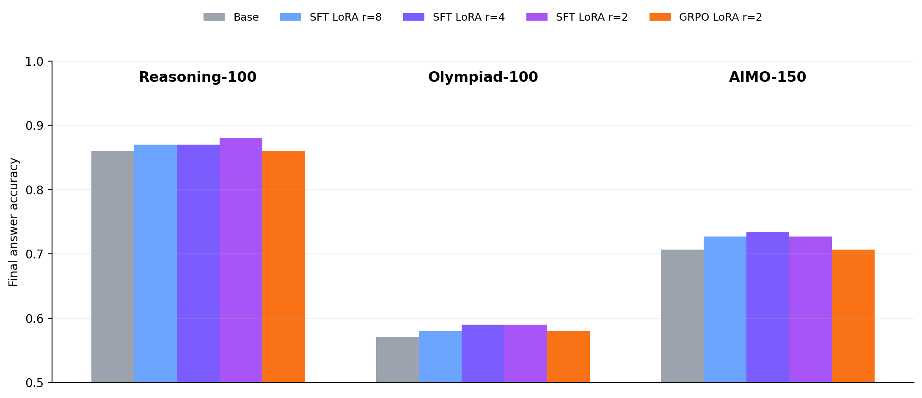
Benchmark Performance
Accuracy across all evaluated conditions
Reasoning-100
Base was already strong at 0.86, but SFT LoRA r=2 still improved it to 0.88. GRPO matched the base and did not add extra gain in this run.
Olympiad-100
This was the closest benchmark: SFT LoRA r=2 and r=4 both reached 0.59, while GRPO reached 0.58. The gains were modest but consistent.
AIMO-150
AIMO favored a slightly larger adapter: SFT LoRA r=4 achieved the best score at 0.733, outperforming both r=2/r=8 and GRPO.
Pattern: Smaller LoRA ranks were enough to help, but the best rank depended on benchmark difficulty and distribution.

Slide 16
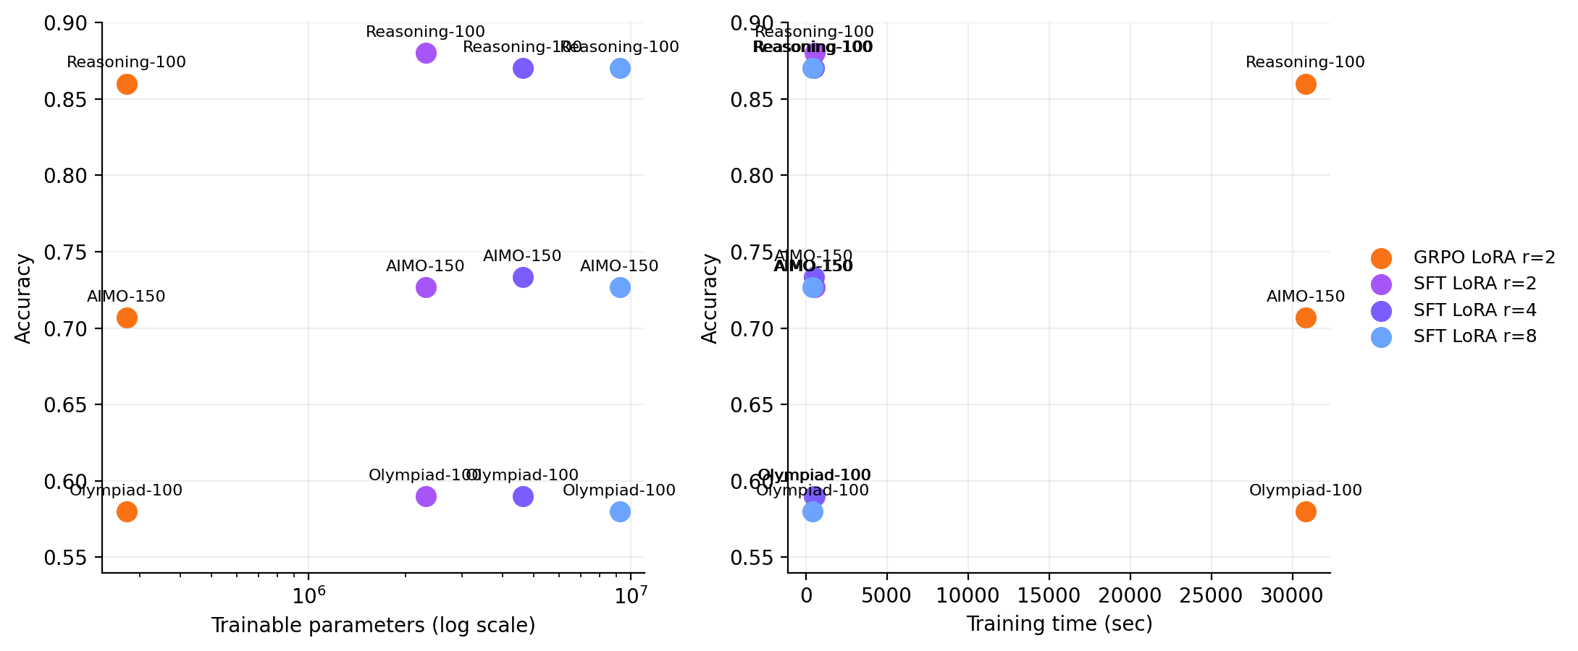
Efficiency Trade-offs
Parameter budget, training time, and where GRPO was strongest
GRPO LoRA r=2 had the smallest trainable budget: 272k parameters (0.0176% of the model), versus 2.31M / 4.62M / 9.23M for SFT r=2 / r=4 / r=8.
That parameter efficiency did not translate into time efficiency here: GRPO took about 30,839 seconds to train, while the SFT runs finished in about 439–555 seconds.
SFT LoRA r=8 was the fastest trained model, yet it was not the most accurate; in practice, r=2 or r=4 gave a better accuracy-cost balance.

Slide 17
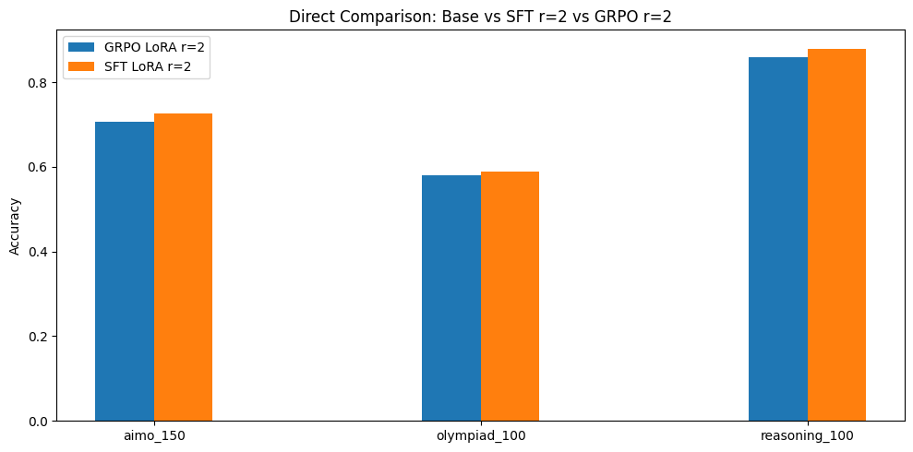
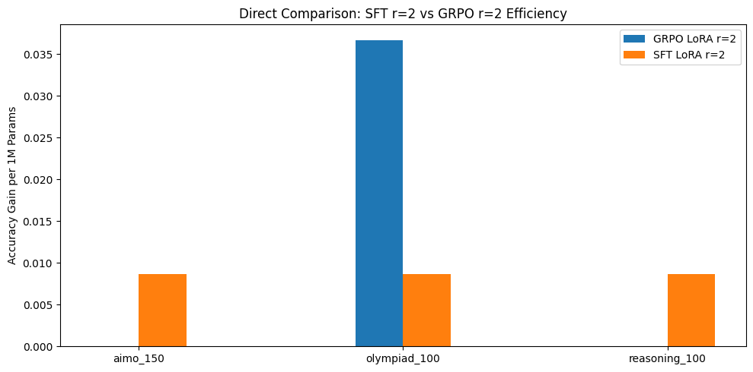
SFT VS GRPO with LoRA Rank=2
Same low-rank budget, different training objectives
Accuracy: Base vs SFT r=2 vs GRPO r=2
Efficiency: accuracy gain per 1M trainable parameters
SFT r=2 beat GRPO r=2 on all three benchmarks in raw accuracy: 0.88 vs 0.86 on Reasoning-100, 0.59 vs 0.58 on Olympiad-100, and 0.727 vs 0.707 on AIMO-150.
GRPO r=2 was much more parameter-efficient on Olympiad-100: 0.0367 accuracy gain per 1M trainable parameters vs 0.0087 for SFT r=2.

Slide 18
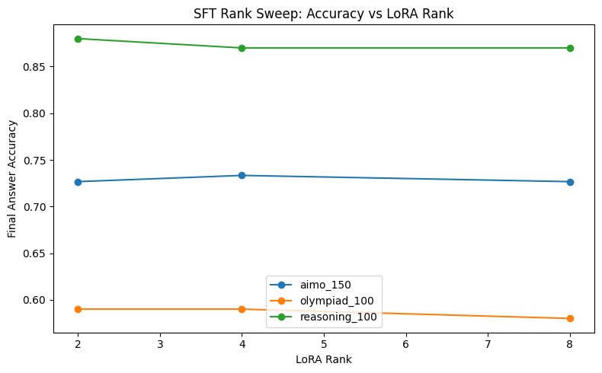
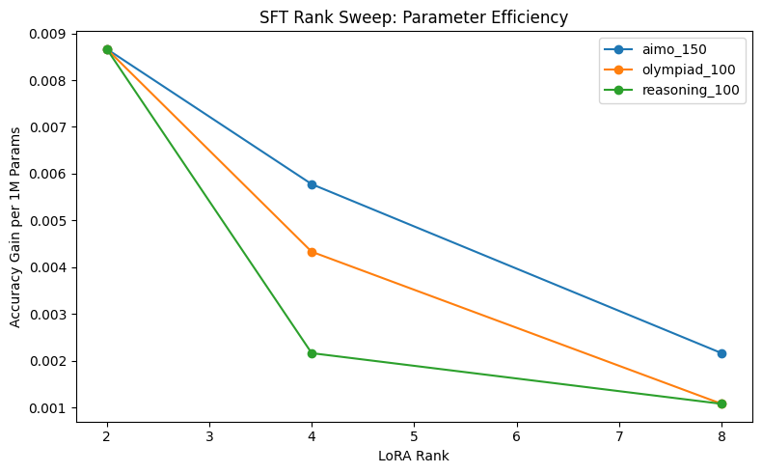
SFT Rank Sweep
Smaller adapters remained strong, but the best rank still depended on the benchmark
Final answer accuracy vs LoRA rank
Accuracy gain per 1M parameters vs LoRA rank
Rank 2 was best on Reasoning-100 (0.88), showing that a very small adapter was enough to improve the strongest starting benchmark.
Rank 4 was best on AIMO-150 (0.733), while Olympiad-100 tied at 0.59 for r=2 and r=4.
Parameter efficiency dropped as rank increased, larger adapters added cost faster than they added accuracy.

Slide 19
06
Key Learnings

Slide 20
Key Learnings
Small LoRA adapters were enough to move reasoning quality. Even rank 2 improved the base model on Reasoning-100 and tied for best on Olympiad-100.
The best LoRA rank was benchmark-dependent: rank 2 fit the shorter reasoning tasks best, while rank 4 was strongest on the harder AIMO-150 set.
In this local notebook workflow, GRPO looked more promising as a parameter-efficiency experiment than as a raw-performance winner. It showed the smallest update budget, but not the best scores
Limitations
This project is a compact local-environment experiment, not a definitive benchmark of post-training methods.
The comparison is informative but narrow: SFT + LoRA was tested at ranks 8 / 4 / 2, while GRPO + LoRA was tested only at rank 2.
Held-out evaluation covered Reasoning-100, Olympiad-100, and AIMO-150; larger benchmark slices would make the conclusions more robust.
The shared deterministic evaluation protocol improved fairness, but training conditions were not perfectly matched.
SFT + LoRA: local MLX workflow with a more efficient training path
GRPO + LoRA: local CPU workflow using Transformers + TRL + PEFT

Slide 21
THANK YOU

